Slide 1

Dyslexia, Behavioural Problems and Depression
Mark Le Messurier for GENERATION NEXT
Understanding the unique health and wellbeing challenges facing our young people and how they can be met
Notes:
Slide 1
Dyslexia, Behavioural Problems and Depression
Mark Le Messurier for GENERATION NEXT
Understanding the unique health and wellbeing challenges facing our young people and how they can be met

Slide 2

This presentation is for the kids who set off to school intending to learn to read and write, but falter because of an unexpected learning difficulty, namely dyslexia
Notes:
Slide 2
Ask most littlies before they head off to school want they want to learn.
They’ll tell you that they want to learn to read. Many have watched their mum or dad do it, and most have gained pleasure over the years as they’ve listened to their mother or father read to them.
Now they want to do it themselves.
They also want to learn how to break that annoying code that mum or dad uses – you know, when parents spell words out loud in front of kids so they don’t know what they’re talking about.
Soon after starting school they realise their learning is not the same as the others. The others scoot through the glorified reading boxes, while they struggle to retain word patterns and sounds. They burn with frustration and/or humiliation because they can’t access the most valuable currency in schools – that marvellous capacity to efficiently process PRINT.
This wasn’t their dream.

Slide 3




Notes:
Slide 3
A dreadful shame slowly replaces their dream to read and write.
A few turn their shame inwards. They disengage and stop trying.
Some become sad, lose friendships and refuse to go to school.
Some become depressed and contemplate the incomprehensible seeing it as a better option than dealing with their shame, in front of peers, every day.
For those with a propensity to act out their shame, the script plays out with great speed by perfecting eruptive emotion and errant behaviour.
Not being able to crack the PRINT CODE still hurts, but at least they gain recognition for something.
How brave are our dyslexic students?
How can they remain emotionally intact when they cannot access the everyday currency so readily available to others?

Slide 4
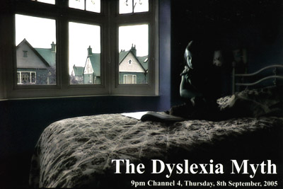
Dyslexic myths
They're slow learners usually with low IQ’s
They’re lazy – ‘if only he’d apply himself’
He can read and write so it isn’t dyslexia
Notes:
Slide 4
There is now more than enough clinical evidence to show that both male and female dyslexics carry elevated negative perceptions of their peers, of school, of themselves and about their academic futures.
It’s what you’d guess isn’t it?

Slide 5
Dyslexic myths
Can’t be - no one else in the family has it
There’s no cure. So why recognise or fund it?
They all write backwards or reverse letters
Notes:
Slide 5
The result is heightened levels of emotional and behavioural turbulence.

Slide 6
Dyslexic myths
If you’re doing well at school you can’t be dyslexic
There is no way to truly diagnose dyslexia
Just get them to read a lot more
Notes:
Slide 6
Every dyslexic can tell about embarrassing and soul-destroying experiences they’ve had at school.
The developing self-image of kids makes them very vulnerable.
Plenty of sadness, anxiety, anger and depression is common.

Slide 7
Dyslexic myths
Repeating a school grade is always a great help
He’ll outgrow his Dyslexia
Dyslexia does not exist
Notes:
Slide 7
And, why wouldn’t it be common?

Slide 8
Dyslexic myths
For those who wish to read the startling clinical evidence about the links between Dyslexia, Behaviour and Depression, I have gathered 13 research articles for you
The last slide today will show you how to access them
Notes:
Slide 8
They’re often labelled as lazy, avoiders, lacking in ability and poorly motivated.
THE EMOTIONAL FALLOUT can be unbearable.
For those who wish to read the startling clinical evidence about the links between Dyslexia, Behaviour and Depression, I have gathered 13 research articles for you.
The last slide today will show you how to access them.

Slide 9
“I don’t want to be here anymore…”
Notes:
Slide 9
See video clip – part one
Here’s Tim’s story, and how he chose to cope with his dyslexia at age 7 …
“Our Timothy had been very flat for most of the summer holidays, but the last couple of weeks were particularly hard for him. He had cried a lot about having to go back to school. A day did not pass without him questioning why he had to go. With a week of holidays left the tantruming subsided, but the tears continued. It seemed he had resigned himself to return to school.
His younger brother and sister were asleep, Timmy was watching the television and I was in the kitchen.
‘Thud.’ A couple of seconds passed. ‘Thud.' A few more seconds passed. ‘Thud’ is the only way to explain the sound. It was deep and powerful like nothing I’d heard before and recalling it makes my heart jump to my throat.
'Thud.’ It got the better of me, so as good mothers do, I went to investigate. Not often did I need to check on Timmy, we had been blessed with a calm, thoughtful child. I made my way into the lounge, stepped inside and looked. There I saw Timmy doing a tall hand stand on the couch.
"Timothy how many times have I told you and your brother?”
'Thud.’
"No. No. No. No. Stop!"
It all hit home. He was lifting himself up as high as he could with his hands on the back of the couch, and then jerked his hands away so his head crunched into the couch seat below. The 'thud' was his feet hitting against the wall helping to propel him with all the more force into the seat.
I grabbed him and pulled him onto my lap.
“You could break your bloody neck if you keep doing this!” I screamed.
“I know,” he calmly responded.
“If you know why on earth are you doing it?”
“I don't want to be here.”
Innocently, I said, “That’s fine. If you’re bored don’t stay here. Go and do something else.”
“No. I don't want to be here. I want to die," he said staring up into my eyes.
He continued, “I don't want to feel this way anymore and if I am dead I won’t have to go to school.”
“You can't help me mum. I'm never going to learn to read”.
I hugged him and sobbed. I couldn't let him go.
Timothy had spent eighteen months in preschool, eighteen months in reception and twelve months in year 1. After four years of formal education he had stalled on the readers from the orange box. Each of them had just a word or two to a page. His best friends were beginning to read the Harry Potter books. A few months later Timothy was identified with a learning difficulty, dyslexia. That helped to explain why he has such confusions, but it hasn’t changed the way he feels about it.
I love our son. I hate our lounge. I still can't think of our beautiful desperate little boy bouncing on his neck because he didn't think there was anything else he could do. Timothy was seven and half when he tried to escape the world because he couldn't read.
Suzie, Timothy’s mother

Slide 10

DISPLAYS OF INADEQUACY
When social recognition not given
REVENGE SEEKING
behaviour
Need for social recognition
When social recognition not given
POWER SEEKING
behaviour
When social recognition not given
ATTENTION SEEKING behaviour
When social recognition not given
Universal need for social recognition
Notes:
Slide 10
What do you need to look out for when it comes to dyslexia, or ‘Dyslexic like’ learning difficulties?
First up, think about the individual’s capacity to cope with this?
Then think about the family’s ability to cope, because they will have a lot to deal with no matter how well things unfold.
Years ago Adler and Dreikers taught us that, when one goal does not deliver the social status a child seeks, they climb – the ladder for social recognition - rung by rung, until their faulty logic allows them to believe they’ve reached a status worthy of them.
Yes, each rung of the ladder represents a deeper level of discouragement for children and teens – TIM REACHED THE TOP OF THE LADDER – he felt so inadequate, so shamed and so humiliated he could only see one solution, and it was dreadful.

Slide 11
DISPLAYS OF INADEQUACY
When social recognition not given
REVENGE SEEKING
behaviour
Need for social recognition
When social recognition not given
POWER SEEKING
behaviour
When social recognition not given
ATTENTION SEEKING behaviour
The Four goals of Misbehaviour
Dreikurs R, Brunwald B, Bronia P, Floy, C. 1998, Maintaining sanity in the classroom: classroom management techniques, second edition, Taylor and Francis, Levittown, PA.
Notes:
Slide 11
It is only when we help kids to meet their needs that we permit them to hop off this ladder of discouragement.
This is our call to duty and where our work lies, and the mission of this presentation.
Literacy under-achievement has high social and economic cost in terms of health and crime.
The evidence shows an overlap between under-achievement in literacy (especially in reading) poor behaviour, poor health and wellbeing and propensity towards crime.
http://research.acer.edu.au/cgi/viewcontent.cgi?filename=2&article=1004&context=tll_misc&type=additional

Slide 12

In February the Prime Minister announced a National reading blitz for all young Australians up to Year 3 to help falling literacy standards in Australia
“Hooray! But we need more - we need a paradigm shift”
Every teacher needs to understand and use the right teaching methods because the right methods offers students a way to achieve
Notes:
Slide 12
Yes, the Prime Minister recently announced a National reading blitz for all young Australians.
Hooray! This in itself is a start, although not before time!
But, what we really need is a genuine paradigm shift that includes;
Direct, continuous, mandatory training for teachers so every teacher can identify students with reading difficulties
Direct, continuous, mandatory training for teachers so every teacher knows how-to teach reading
Direct, continuous, mandatory training for teachers so every teacher knows what the research says and how to respond to it appropriately – we have to STOP failing to respond to the research - the right methods empowers every student.
For too long too many educators have persisted arguing over whether a ‘whole word approach’ to reading is better than a phonics-based approach.
And, what does the RESEARCH tell us about this silly and dangerous argument?
It tells us that the ‘whole word’ approach is our end goal for everyone. That’s the objective! But, it informs us that phonics is a necessary synthetic aid to help kids make sense of a complicated irregular and ridiculous language.
We also need a paradigm shift that turns every teacher into a ‘whistle-blower’ on kids that are having trouble acquiring their reading skills – especially in the early years.
Let’s do away with educators saying to parents;
“Don’t worry, his reading will come together.”
“It’s alright, boys take longer to read.”
“Let him read at his own level”
When kids are struggling to read it is not alright.
At that point we need to assume that they’re in trouble. We must assume they are dyslexic and give them ongoing, sequenced instruction, just like we’d provide to a formally diagnosed child.

Slide 13

A specific learning difficulty (SLD)
when individuals (15%) do well in some areas of learning,
but unexpectedly have problems in others
Dyslexia or Reading Disorder (10%) is a language based /information processing difficulty, neurological in origin, affecting the phonological component of language, and memory as well. Curiously, it is not just about reading. Students with SLD’s may also have problems with number skills - dyscalculia and writing capacity - dysgraphia
Up to 25% of the population is affected by some form of language-based or ‘Dyslexic styled’ learning difficulty
4 males to 1 female are currently being identified as Dyslexic
About 4% of the population are considered severely dyslexic
Notes:
Slide 13
Specific Learning Disability is a broad umbrella term.
It attempts to explain why a person can do relatively well (even really well because they can be gifted) in some areas of learning, but encounter unexpected and particular problems in other areas.
Best estimates tell us that about 25% of the population are affected by some form of language-based learning difficulty.
We think SLD’s probably account for about 15%. But, we’re likely to be underdiagnosing by about 8%
Dyslexia affects about 10% of the population .That's 3 kids in every class room.
About 4% of the population are severely dyslexic.
It is inherited - 6 genes have now been linked to the disability.
It affects the way an individual processes information and language, and is on a sliding scale of severity.
Dyslexics may also have issues with planning, organisation, co-ordination and handwriting. In combination, their listening comprehension may be affected, especially when under pressure.
Interestingly, SLD’s have really only 'existed' since we’ve have had to learn to read, write and do maths.
They became evident after some bright spark introduced the dictionary, and called for standardised spelling. We’ve got a scapegoat – apparently we can blame Samuel Johnson who created the first dictionary in 1755.

Slide 14
The 4 subcomponents of phonological dyslexia - core problems
There’s visual dyslexia
There’s phonological dyslexia (neurologically based)
There’s combination visual and phonological dyslexia
Ability to break words down into sounds, to hear the sounds and syllables, be able to discriminate these sounds, and to manipulate them
The capacity to break the alphabetic code - recalling the letter, naming the letter, recalling the sound and naming the sequence of sounds to make a word
How fast objects, pictures, colours, letters or numbers can be recalled aloud - RAN time is a strong predictor about reading ability
Together, they aid in the remembering of instructions (how-to, times and places), sight words, spelling patterns, times tables and the acquisition of phonics
Phonological
awareness
Rapid
Automatized
Naming
(RAN)
Auditory working
Memory and
Visual memory
Visual-
orthographic
processing
Notes:
Slide 14
The image on the screen summarizes what’s usually termed ‘the dyslexic impairments’.
I’d prefer for you to see them as ‘ a window into a dyslexic’s learning preference.’
Once you get this you get how a dyslexic learns.
What are the markers or indicators that a child may have dyslexia?
Early on kids have difficulties pronouncing longer words, and finding the right word. At first it may seem cute! They are may also have word finding difficulties.
Early on, good teachers notice difficulties in their ability to acquire basic reading, writing and spelling skills. The link between sounds and letters do not develop as it does for others.
Their reading lacks fluency and speed.
They trip over small common words like was for saw, and they for that. They read words that are not there, keep forgetting the same simple words and lose their place. They sound out syllables as they read, but forget them before they are able to blend the entire word together – it is so frustrating for them. Yet, their reading comprehension is so much better.
Later on, these are the kids who can learn for their spelling test and get ‘good’ marks. Then, when tested on the same words three weeks later they achieve poorly.
A common observation is that they spell words their way - very phonetically.
They make it look so much simpler than this convoluted irregular language we’ve inherited with - 26 letters and 44 sounds!
And, dyslexia may be in the company of dysgraphia - a writing impairment.
Kids with dysgraphia are often slow to learn to write; may experience letter reversals, produce inappropriately sized letters, mix upper and lower case letters, forget word spaces and produce untidy and inaccurate bookwork. These students just can’t seem to get their great ideas on paper.
Mathematical difficulties, called dyscalculia, may be present as well.
Indicators include persistent number reversals (e.g. 37 becoming 73), copying inaccuracies and continual misreading of written information so that mathematical outcomes are messed up. These students often say, “that’s an adding sign, isn’t it? Or is it a multiplying sign?”
They have difficulty retaining simple formulas, remembering the sequential steps involved in basic maths operations and recalling number patterns (especially the multiplication tables – many will never be able to learn them all).

Slide 15
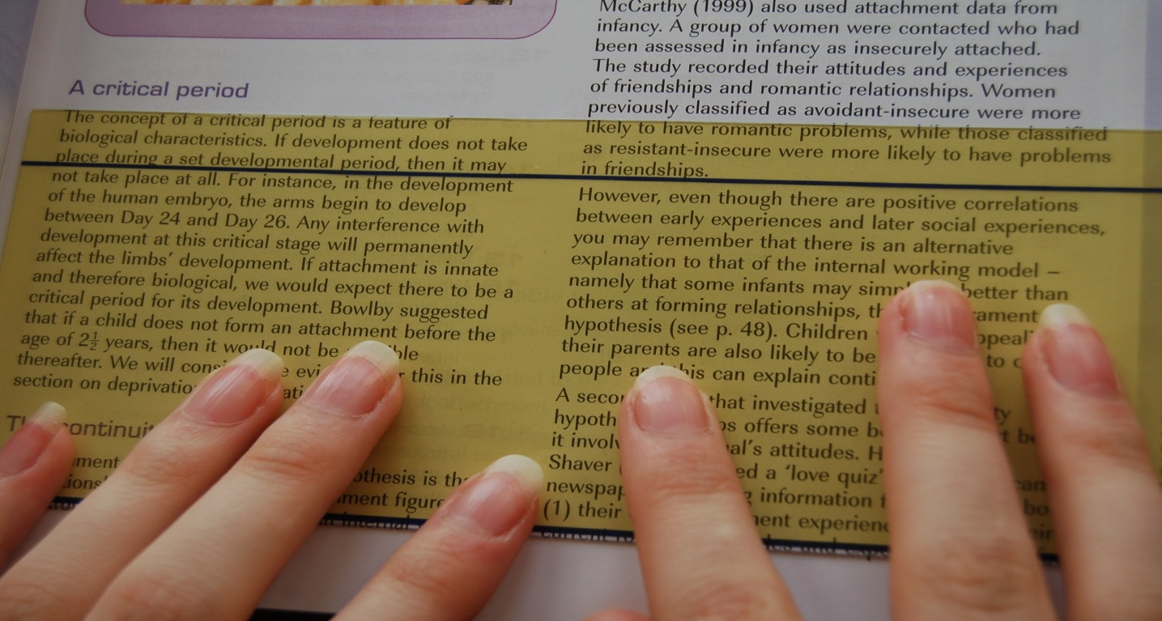
A quick word on visual dyslexia
Download your Open Dyslexic Font from http://opendyslexic.org/
Notes:
Slide 15
Coloured filters, either worn as glasses or used as plastic overlays, have been used in supporting those with visual dyslexia for a long time.
They have, in the past, caused controversy because there is no agreement about how or why they work.
It is thought that by reducing the bright contrast between the print and the bright white paper, activation of parts of the brain involved in directing attention, is modulated. As a result there is less visual stress.
A few students with visual dyslexia find help by using a coloured plastic overlay – they say the words suddenly stop swimming or moving about on their page.

Slide 16
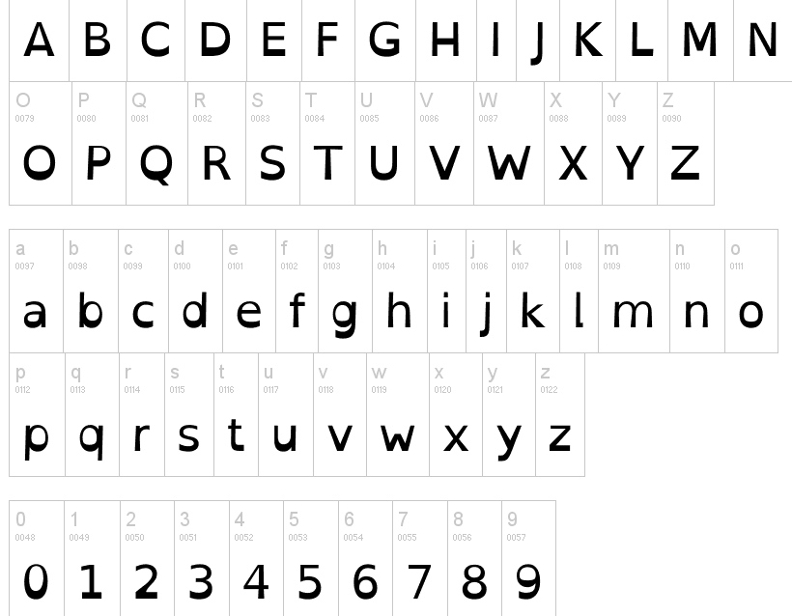
A quick word on visual dyslexia
Download your Open Dyslexic Font from http://opendyslexic.org/
Notes:
Slide 16
The best advice is to keep a selection of coloured overlays and let students try them, not just your dyslexic kids!
They’re cheap – just go to Office Works and buy some coloured plastic folders, cut them up and they're ready to go.
I prefer blue. Have a go yourself!
Some take this a step further and scrap the use of white paper to print on by replacing it with gently coloured paper.
Oh, don’t forget about the OPEN DYSLEXIC FONT
It’s a font deliberately created to increase readability for dyslexic readers.
It’s bottom heavy and has unique character shapes help prevent letters and numbers from being confused.

Slide 17
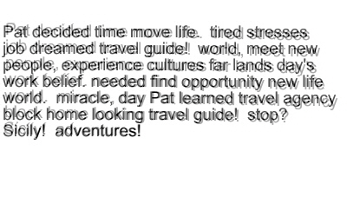
Read the following passage
What’s happening as you read this? How hard are you working to make sense of it? I’ve added a little distortion to help you ‘feel’ the confusion.
Tell your neighbour what it means!
2
Notes:
Slide 17
Here’s a practical activity - read the passage.
Can you make sense of it? It’s tricky!
In other words, how well can your intellect, common sense and comprehension skills work together to make sense of this?
I’ll give you a few seconds to sort it through.…. wait 25 seconds…
Stand up and sit down if you think you made pretty good sense of it?

Slide 18
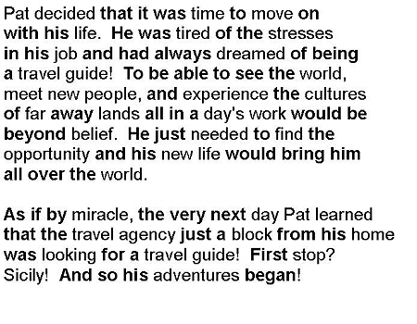
Below is the original passage
In a typical paragraph ‘everyday sight words’ average 60%
Notice how many of these the dyslexic reader missed and the difference it makes. Now you’re getting the picture!
2
Notes:
Slide 18
Here’s the original on screen.
What you’ve just experienced is the ‘hard work’ it takes many dyslexics to process print.
Now you’ve got an ‘idea of how it feels’ to read as a dyslexic.
Imagine doing it like this every time you had to read?
The comment classically made about the reading of a dyslexic is, “despite their reduced reading capacity (in this case skipping many of the sight words) it is surprising how good their comprehension is.”
But, it comes at a cost – they have to work so hard – just like you did!

Slide 19
Read this!
THE PAOMNNEHAL PWEOR OF THE HMUAN MNID?
Aoccdrnig to a rscheearch a cmabrigde uinervtisy it deosn't mtter in waht oredr the ltteers in a wrod are,the olny iprmoatnt tihng is taht the frist and lsat lteer be in the rghit pclae. the rset can be a taolt mses and you can sitll raed it wouthit porbelm. tihs is bcuseae the huamn mnid deos not raed ervey lteter by istlef, but wrod as a wlohe.
… paomnnehal isn’t it?
Now you see why many dyslexics can gain better than age appropriate reading comprehension despite taking so long to read and with such decoding difficulties
Notes:
Slide 19
Read this!
Paomnnehal isn’t it?
This is why many dyslexics can get age appropriate reading comprehension score despite taking so long to read, and with such decoding difficulties

Slide 20
“Copy this from the board!”
Your task - copy and substitute each vowel with an @ - start now!
Dyslexia is a neurologically-based condition. We now know that it is inherited.
It causes problems with reading, writing, spelling and is usually linked to difficulties with concentration, short term memory and organisation.
Dyslexia is not the result of low intellect, stupidity, nor is it a gift. It is not caused by poor schooling, poor home background, poor motivation for learning, poor eye sight, poor hearing or muscle control - although it may occur with these conditions.
Notes:
Slide 20
Here’s one last task!
All I want you to do is to copy from the screen on to a sheet of paper.
Please substitute each vowel with the ‘@’ symbol.
I want you to start now!
Hurry up… push them along... hurry them along….
What feelings did you experience as you forced yourself to do this exercise?
Was there any frustration, annoyance, distress or anger?
I’m sure there was.
And, I’m sure there were a few of you who had to push yourself even to engage in this exercise. That makes me really happy - because you mirrored the feelings many dyslexic students feel when repeatedly asked to copy from the board and have to battle intense memory shortfalls as they do it.

Slide 21
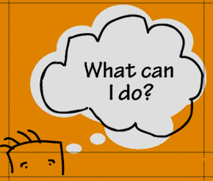
Take home tips
Dyslexia, behaviour and depression?
Consider the child’s coping capacity, and the quality of support they have around them
Consider co-Morbid conditions with Dyslexia –
it isn’t always just about Dyslexia
Most common…
Dyscalculia
Dysgraphia
ADD and ADHD
Anxiety disorder
Autism Spectrum Disorders
Others can include…
Conduct Disorders
Oppositional Defiant Disorder
Auditory Processing Disorder
Tourette's Syndrome
Sensory Impairments
Notes:
Slide 21
Whatever your role, you have to know that the road ahead for a dyslexic child or teen is tricky – they face a long tricky road BIG ups and downs.
Based on this, consider their coping capacity - this disability requires big doses of resilience!
Are they a ‘glass half-full’ kind of person?
Are they more likely to blame others, or live in denial?
Are they a positive problem solver with determination?
Are their parents’ positive problem solvers?
Does depression or anxiety also run in the family?
Does the child know what dyslexia is?
How do they feel about having dyslexia?
Do their parents really understand it? Does it run in the family?
Might a short SPELD course on dyslexia for parents increase their understanding?
Do you know sensible, grounded parents with a Dyslexic child you might link them up with?
Do you need to refer them to a psychologist who can counsel the parents and/or the child – even if it’s to set them on the right road with the right kinds of resources, understandings and contacts? As you know, the ‘Better Access’ Medicare initiative aims to improve access to psychologists for adults and children with difficulties such as anxiety, depression or extreme behaviour problems that are affecting social skills, behaviour or thinking.
And, this is the time to know that dyslexia is a co morbid condition.
There is a high co-morbidity with dyslexia and ADHD – about 65% of those with ADD have dyslexia as well.
We need to be mindful of comorbidities.

Slide 22

Take home tips
Is it Dyslexia? Dyslexia checklists are available;
‘Dyslexia Screening Test’ and checklists
http://www.pearsonclinical.com.au/productdetails/115/1/62
http://www.dyslexiavictoriaonline.com/chofdyin.html
http://www.dyslexiaaction.org.uk/dyslexia-check-list
http://www.bdadyslexia.org.uk/dyslexia-check-list
http://www.dyslexiaa2z.com/learning_difficulties/dyslexia/dyslexia_checklist
Notes:
Slide 22
If you think a child may have dyslexia, get hold of a dyslexia checklist, or better still, learn how to use Angela Fawcett’s, Dyslexia Screening Test. This revised Screening Test now covers primary and secondary students.
It will NOT give you a definitive diagnosis, but if it looks like ‘Dyslexia,’ or ‘Dyslexic type issues’ are at play, then assume they are, and begin some very explicit literacy interventions and sensible provisions good for all kids.
This is the moment to ask why the Australian Education system lacks a failsafe early reading screening system for all kids - it the lack of a national screening system is a disgrace, and I think we should be as mad as hell about it.
If you choose to refer kids to a psychologist to screen for Learning Disability, be sure to refer them to a skilled psychologist.
Remember– not ALL psychologists are adept at identifying dyslexia, especially in young children. Some psychologists in some systems have long been discouraged to mention the Dirty ‘D’ word - Dyslexia.
Skilled psychologists can find strong dyslexic markers in children as young as 3 or 4 years of age. Results certainly become more accurate as kids approach 7 or 8 years of age.

Slide 23

Take home tips
Dyslexia Aware Schools
What do they look like?
  Excerpt of a letter written by a year 11 student to his history teacher
  “You don’t get my dyslexia and it would really help me if you did. If all you want me to do is write essays all the time then all you are testing is my learning disability and I’ll just keep showing you I’ve got a really BIG one!”
What does a ‘Dyslexia Aware School’ look like?
‘Dyslexia Aware Schools’ program - info@actiondyslexia.co.uk
http://www.theage.com.au/national/education/seeking-a-new-deal-on-dyslexia-20100528-wl5z.html#ixzz28pg7CF9b
Notes:
Slide 23
Dyslexia Aware Schools? What do they look like?
Firstly, the ‘Dyslexia Aware Schools’ program is currently being promoted by the UK’s Neil MacKay, and supported by a number of parent and SPELD groups throughout Australia.
Thanks to Neil and others, many ‘Dyslexia Friendly Schools’ already exist in the USA, Ireland and the UK – so great models already exist!
A lot of the discussion about dyslexia here in Australia remains the dark ages.
We still hear debates as to whether the condition even exists.
And, apart from New South Wales, it is not legally recognised as a legitimate learning disability in most school systems.
This has got to be changed.
What does a ‘dyslexia aware school’ look like? They’re pretty unremarkable really… they are schools where…
there’s NO stigma about having a learning difficulty – dyslexics simply have different learning preferences and are recognised as needing other ways to express and get information.
the progress of students is tracked to ensure no student slips through the cracks
the hurdles students face are acknowledged and ways are found to help them learn to cope from an academic and wellbeing basis
there’s easy access to text-to-speech and predictive typing software to support the production of text
teachers receive specialised training about how to teach reading and spelling, how to compensate for poor memory and organisation and how-to deliver strategies to help kids attack text successfully
parents are provided with mainstream, information about how they can support their child’s reading and achievement
there are continuing audits and reviews to help everyone grow
Actually, ‘dyslexia aware schools’ work for everyone. Why?
Because it’s called – “good teaching.”
Until ‘dyslexia aware schools’ begin popping up around Australia – and they will, you’ll have to get out there and hunt down good schools with great teachers.
They do exist – there are willing and skilled teachers who understand dyslexia, wellbeing and teach brilliantly.

Slide 24
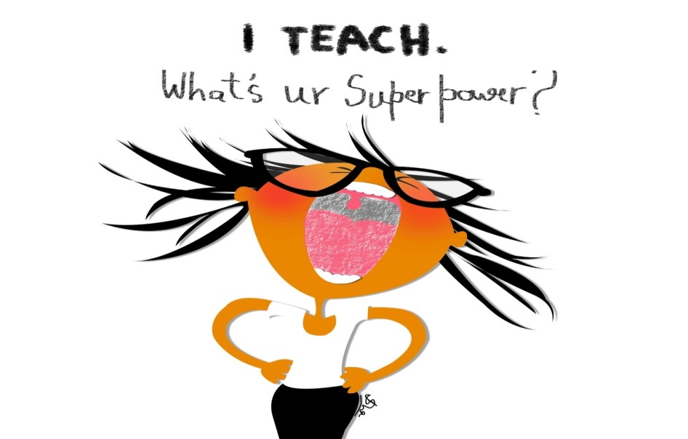
Take home tips
Dyslexia Aware Teachers
What do they look like?
They demonstrate untiring faith to help ALL students find solutions and success
They know how to ‘normalise’ and ‘compartmentalise’
They know how to make students feel safe and supported
They see ‘Learning Disability’ as a ‘Learning Preference’
They start by recognising strengths - they move from what students CAN do to the things they find difficult
They investigate dyslexics who have lived good lives and made great contributions…
Orlando Bloom, Charley Boorman, Keanu Reeves, Kiera Knightley, Billy Bob Thornton, Alexander Graham Bell, Cher, John Lennon, Richard Branson, Henry Ford, Walt Disney, Tommy Hilfiger, Pablo Picasso, Jackie Stewart, Agatha Christie, Paul MacCready, Winston Churchill, Napoleon Bonaparte, Charles “Pete” Conrad Jr., Robbie Williams, Billy Connolly, Charles Darwin, Galileo Galilei, Orville and Wilbur Wright, Albert Einstein, Jessica Watson, Kerry Packer, Ernest Hemingway, F W Woolworth, Lugwig Van Beethoven, Harrison Ford, Henry Winkler ……..
Notes:
Slide 24
Dyslexia Aware Teachers? What do they look like?
I’m sorry to disappoint you, but the best are usually unremarkable too – they’re always practical and compassionate.
First up, they actually know how to teach READING, and how to continue to teach reading for students who don’t get it in the first or second flush.
They refuse to trot out isolating phrases like;
“You’re in grade 3. You need to be more independent”
“Just do what works for you”
“If you can’t do it speak up!”
“It would be easier if you read more”
Instead they want to go on the learning journey with kids and become resourceful because they walk with the student and learn what works.
They have a capacity to reassure students – and their parents - that they’re not the first person or family in the school or the world to have Dyslexia.
They give kids – and families - the impression that they are walking on a well-trodden path with them.
They provide hope.
They are able to reassure them that many well-known dyslexics have done really well with their lives – oh, yes, they have a great selection of youtube ‘famous dyslexic’ clips to reinforce this and talk around.
They also realise that Dyslexia runs in families, and sometimes inspiration can be very close to home – their mother, father, auntie, uncle, cousin or grandparent.
And, what about, yourself, another teacher or the principal – it happens! Good homegrown and close to home models can be inspirational blue prints.

Slide 25

Source; http://www.pnas.org/content/early/2012/08/27/1206628109.full.pdf+html
Assisted listening devices do benefit dyslexic kids
Notes:
Slide 25
Is there a relationship between dyslexia and auditory processing difficulties?
Well, the jury is out.
However, researchers have learnt that auditory processing difficulties impact initially on auditory modality and receptive language, and subsequently on reading ability.
A new study just last year assessed the impact on 19 dyslexic children wearing a personal FM system (similar to a Bluetooth receiver) throughout the school day for one year.
The matched control group of 19 children did not use the FM systems.
However, they were in the same school, also with dyslexia and also involved in the same intervention programs.
These results are consistent with a previous study by Flexer and colleagues who also reported that dyslexic children using an FM system showed greater gains in reading-related skills than children in the same academic environment.

Slide 26

Mentoring, ‘supporting student attachment’
“The gift of mentorship is being able to walk alongside our youth, seeing and feeling the issues they face and sending the critical message that we care.”
Lisa, Educational Support Officer, Cabra Dominican College
Notes:
Slide 26
Putting all the data together we see a picture suggesting than dyslexic males and females cope and behave differently with their dyslexia.
Generally speaking, we learn that dyslexic females suffer from poorer general and academic self-esteem, and they use stronger emotional to avoid and cope. This is more likely to result in sadness and moderate depression.
Males, on the other hand, seem to score closer to ‘normal’ academic self-esteem and just below ‘normal’ general self-esteem.
Males are less likely to use emotion to avoid, and they’re less likely to become depressed over their learning difficulty. However, they are more likely to become obviously disengaged with learning.
Until recently, counselling – especially in schools - has been given a low priority in the treatment of dyslexic children and teens.
We now know that some children and teens are very receptive to counselling as it helps to reduce the despair they can feel.
We have also learned that a counselling approach in conjunction with a quality remedial approach is more successful than using a remedial approach alone.
Oh, and research tells us that counsellors do not need to be highly skilled professionals - any adult who can be warm and sympathetic with limited training could fulfil this role.

Slide 27

A complete set of ‘Mentoring Workshop notes’ can be found here. They are free and are the basis of the program I developed for Catholic Education in South Australia 7 years ago
http://marklemessurier.com.au/main/mentoring.shtml
“We’ve had to find a way to make mentorship work. The issues our students face are too complex to discount this therapeutic initiative just because it’s not the way schools have done things in the past. This sort of program is here to stay. I think it is a forerunner to proposals that will eventually become mandatory in schools.”
Tony Hayes, Student Wellbeing, Sacred Heart Middle school
Notes:
Slide 27
Good counselling/ mentoring models already exist.
They impact – humanely – on students, and positively influence the cultures of schools.

Slide 28
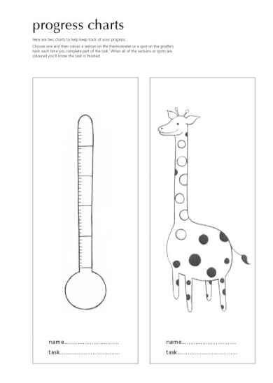
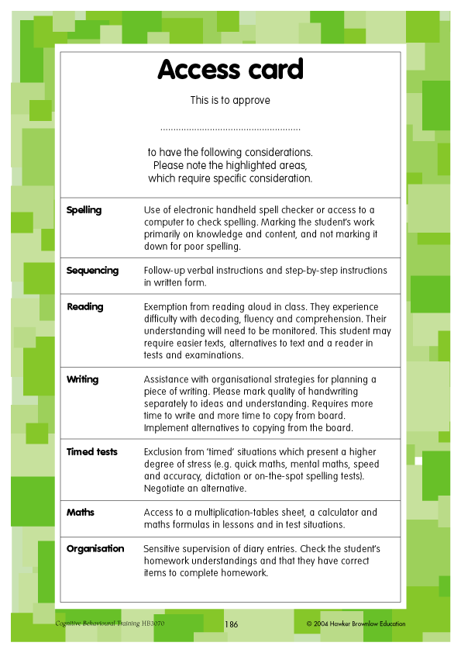
Take home tips
  Dyslexia won’t go away
  Meet the memory challenge by using schedules, charts, lists, calculators, formula sheets, weekly planners, word processors, sticky notes, etc.
CHUNK tasks to reduce memory load -
increase visual cues/ reminders with hints, starters and memory joggers
Differentiate Curriculum and expectations
An ACCESS CARD can be fastened into the back of the student’s diary with the special provisions highlighted
Notes:
Slide 28
A popular idea used in many schools is something similar to this - 'student access cards’.
The card, actually details the special provisions or adjustments the student is entitled to, and has been agreed to.
It’s simply fastened into the back of their diary so it can be discretely shown to a busy subject teacher or a relieving teacher. The ‘access card’ is likely to state… this student requires;
exemption from reading aloud in class
handouts instead of coping notes from the board
extra time in tests and exams
use of computer in lessons and tests
use of calculator in lessons and tests
work to be marked without penalty in relation to spelling and grammar
provision of a reader or a scribe in tests
The end goal is to skill students to become confident enough to speak directly with teachers about their needs and entitlements

Slide 29

Take home tips
Treatment of dyslexia
- a word to the wise
When in doubt about a program, check the Macquarie University briefings;
http://www.musec.mq.edu.au/community_outreach/musec_briefings/#MB23
Do your homework - Multisensory programs that teach RULES as well as GOOD TEACHING are still by far the best approach we have to assist dyslexic learners
Quality programs as;
Hickey, Multi-lit, Toe by Toe,
Jolly phonics, Alpha to Omega and
Phono-Graphix
Quality software programs as;
Mike Joes’ Nessy, The Reading Doctor,
Units of Sound, Rapid Reading and
Wordshark
Notes:
Slide 29
Everything that glitters isn’t GOLD
Yet, there’s a gaggle of aggressively marketed programs (often computer based) claiming to “rewire the neural language circuits” and alleviate dyslexia, amongst all kinds of other things.
Sadly, quite a few have ended up in schools, and by doing so, they have morphed into having some form of legitimacy.
Instead they dupe teachers, parents and children.
This is despite independent studies showing quite a number have no to poor transfer effects.
Oh my goodness – what’s the impact of these useless or benign programs on a hopeful child?
They reinforce failure.
They reinforce the power of their reading difficulty.
They reinforce a child’s shame and despair, and urge kids to see themselves as disabled.
We need to be much clever about managing interventions – always in the context of acknowledging their strengths what they can do well.
Hey, nothing has changed since an Australian Government Inquiry into the Teaching of Reading in 2004.
It said - ALL students will benefit most from methods that EXPLICITLY teach reading.
Methods that highlight the relationship between; phonology and orthography in language, that help students to ‘break the code’ and master text-attack skills to aid in comprehension.
It emphasised that the explicit teaching of reading needs to continue much, much longer in schools, well past junior primary for many, and well into secondary school for some.

Slide 30

Take home tips
Treatment of dyslexia
Early intervention needed
It won’t go away, but their confidence to learn will
Some Apps with phonological bias are ‘useful’- http://dyslexiahelp.umich.edu/tools/apps
Dyslexics learn differently - help them discover they CAN learn differently - it will empower them!
Notes:
Slide 30
There is no cure for dyslexia, but it can be remediated with proper teaching and training.
The approach has to be structured and very consistent.
Specialist early intervention – often with a skilled teacher or speech pathologist – has been a well-trod path for families who can, and cannot, afford it in the past.
It takes BIG commitment by kids and parents – and when done privately can be very costly. These are big barriers for success.
You see, good remediation has been sourced outside of school systems because it simply hasn’t been present in most schools. In fact, as I mentioned before, there’s been a backdrop in some systems where Dyslexia did not exist for a long, long time.

Slide 31
Take home tips
Treatment of dyslexia
Just doing more ‘reading’ or ‘schoolwork’ won’t work
Research supports the ‘Orton-Gillingham Multisensory Method’
One example is the ‘Hickey Multisensory Language Course’
explicit training in phonics, phonemes and morphemes
focus on decoding (word work) in combination with spelling rules and how they work
reading of progressively more difficult texts – highly structured
practice of comprehension strategies while reading texts
http://www.ortonacademy.org/approach.php
Don’t forget - get eyes checked by a behavioural optometrist. Ask for visual attention span and visual stress to be assessed too
Notes:
Slide 31
What we have learnt is that good Dyslexia specific intervention is wonderful explicit reading intervention for ALL kids.
The Orton-Gillingham Multisensory Method - developed in the early 1930's - has special way of teaching phonemics and language structure to dyslexics. Research supports its approach.
We know that the BEST interventions have to focus on:
explicit training in phonological awareness
strong focus on decoding or word work
the reading of progressively more difficult texts
practice of comprehension strategies while reading texts

Slide 32
Take home tips
Assistive technology
Go to services/SPELD SA blog
http://speldsa.wordpress.com/
Free Natural Reader Version 11
Talks text from anywhere out loud to listen to - simple and free!
Free 7 Sticky Notes
Great way to help students plan, stay on task and remember
Speak Selection tool on iPhones, iPads and iPods
It can speak from any text - can gather information from web pages
Dragon SpeakingNaturally Premium Edition
Voice recognition software remains hard to train, but can be brilliant!
Audacity
Free recorder - to record ideas or to record assignments
Echo Smartpen
Wirelessly transfers your written notes and audio to a computer or tablet
Notes:
Slide 32
Never think that assistive technology should be delayed until dyslexic students learn the basic skills of handwriting, spelling, grammar or reading first.
Hey, these kids learn differently, and no matter how well they are taught many will never cope with these rudimentary skills.
They need legitimate options such as - calculators, phones hand-held organisers, mobile phones and ‘stickies’.
And don’t forget Microsoft Office Outlook . It contains wonderful little memory joggers to set up lists, schedules, time lines for assignments and reminders.
Why make someone agonise over their memory difficulty when they could use a device to take the pressure off?
Not only does this practical approach allow kids to access their higher level thinking skills more easily, but helps to buoy their motivation as successful learners.
This is a ‘dyslexic friendly’ approach!

Slide 33

Take home tips
Social skills
Learning difficulty does not always confine itself to academics
It can impact on how an individual perceives the world; how
they listen, remember, respond, problem solve and interact with peers
For a comprehensive list go to;
http://www.whatsthebuzz.net.au/main-menu/social-and-emotional-learning-links
Notes:
Slide 33
Feeling humiliated or sensitive about learning most lessons doesn’t set the perfect footing for reciprocal friendships.
It’s hard to cement friendships with someone who’s a bit too enthusiastic, is moody, who has a ‘chip on their shoulder’, who is too sensitive, who thought jumps, who forgets and seems a bit stuck in their world.
And, the research is crystal clear - without adequate social success children and adolescents are far more likely to be at risk from emotional and mental health difficulties!
The impact of attaching to peers is significant.
Sometimes an edge can be found by immersing kids in a formal social-skills training program - with peers - where they’re explicitly taught how to behave in pro-social ways benefits.
They also engineer opportunities for kids to feel the embracing comfort of warm interactions with peers.
There are some quality social skills programs about, and they can be easily tracked down.
And, never forget to mention to parents the value of clubs, associations and social groups that exist in the local community.
What a way to connect socially over an interest. What a fabulous way for a young person – a person of any age – to find vale in themselves and in others!
Gather up your contacts and distribute them to support young people and families make healthy connections.

Slide 34
Meet Tim…
Notes:
Slide 34
Meet Tim
You’ve probably guessed. Tim did grow up, and it hasn’t been without its struggles.
He’s 15 year old now. Here he is… see 2nd film clip

Slide 35
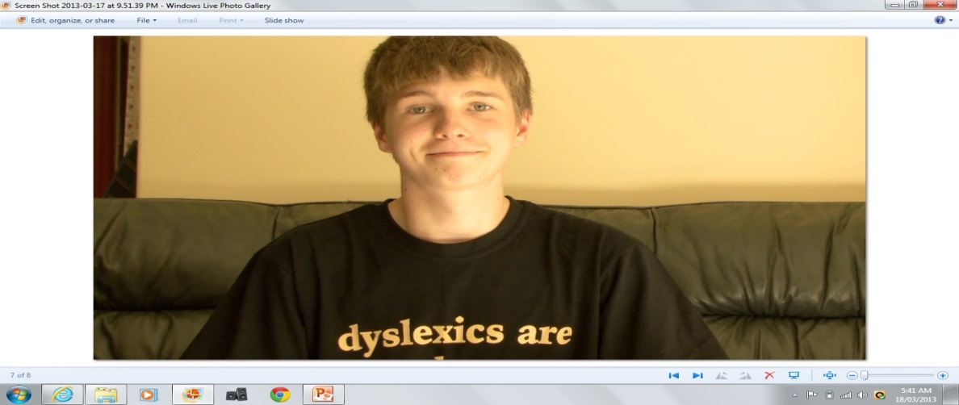
Thank you!
This PowerPoint, notes, references and additional articles, as well as the video from the presentation, are available as a gift from my website; http://marklemessurier.com.au/main/
workshops/teacher/
See ‘Teacher Presentation 13’
Take a look at REFLECTIONS ON DYSLEXIA at www.marklemessurier.com.au This 20 minute film invites you into the lives of four adults who live with Dyslexia. They discuss the emotional issues, and how Dyslexia has influenced their health, choices, behaviour and opportunities
"It's best to build a boy, than to mend a man.”
Dyslexia Aware Schools can change the lives of students with Dyslexia
For more information or to help contact;
http://www.dagbags.org.au
https://www.facebook.com/pages/Dyslexia-Support-South-Australia/224633004229179
Neil MacKay at - info@actiondyslexia.co.uk
or your local SPELD organisation
Notes:
Slide 35
Thanks, Tim
By the way you should know that the video clips you saw today were filmed and produced by a year 11 student.
His name is Jono. Thank you, Jono.
Besides being a terrific human being Jono is also hugely dyslexic.
He says he wouldn’t give his Dyslexia away in case he lost some of his filmmaking talent and passion.
Jono has found his strength and has received support to capitalise on it!
To finish up I want to leave you with one thought…
We need to view the success of our dyslexic students in schools and in our community as a LITMUS TEST.
If they're failing – academically, behaviourally or emotionally – then we know our practice is falling short of meeting the individual learning preferences of many.
When we truly get our ‘reading’ and ‘general teaching practice’ right for dyslexic students – the bonus is, we’ll get it right for all students!
Thank you

